Slide 1
SMB University: Cisco SMB Foundation Solutions
Networking Fundamentals

Slide 2
Objectives
Describe the function and operation of a hub, a switch and a router
Describe the function and operation of a firewall and a gateway
Describe the function and operation of Layer 2 switching, Layer 3 switching, and routing
Identify the layers of the OSI model
Describe the functionality of LAN, MAN, and WAN networks
Identify the possible media types for LAN and WAN connections

Slide 3




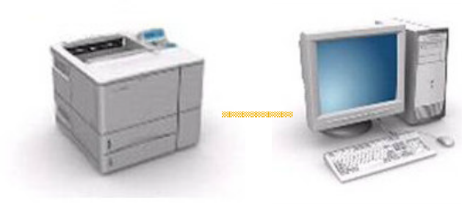

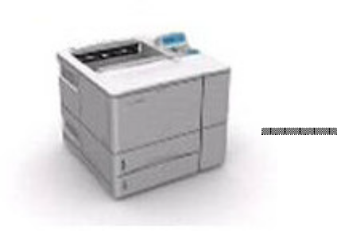
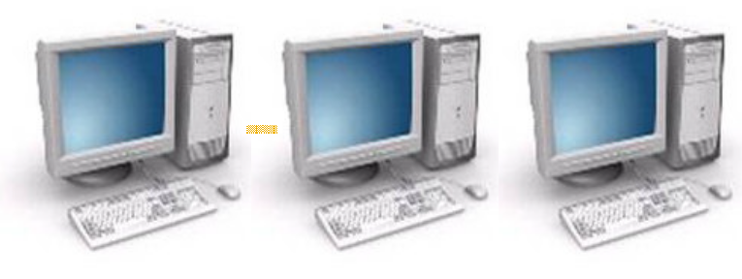
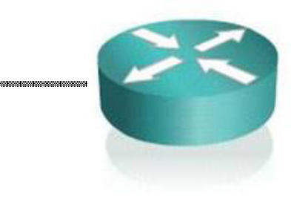



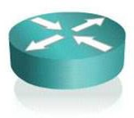
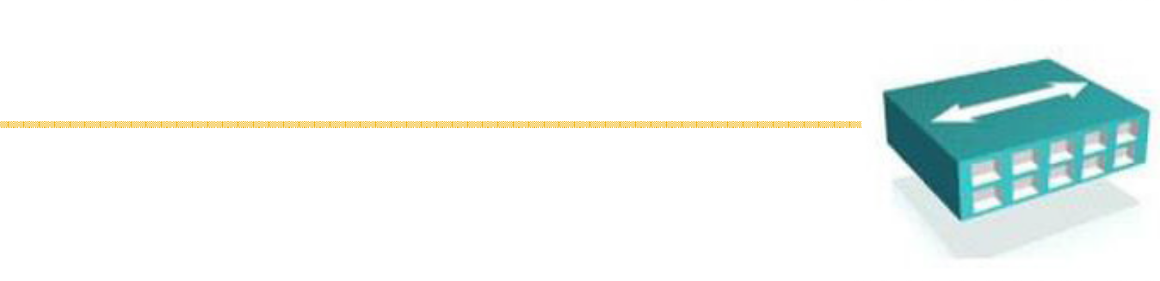
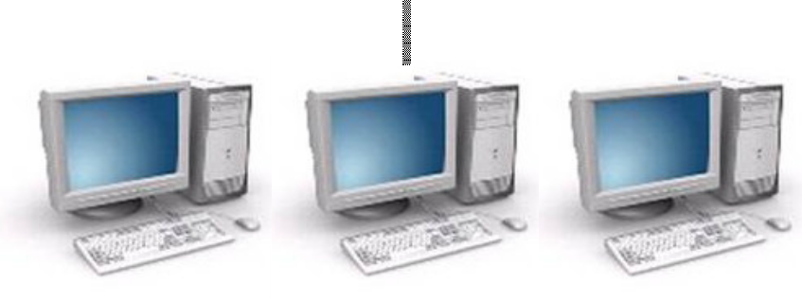


What is a Network?
A network refers to two or more connected computers that can share resources such as data, a printer, an Internet connection, applications, or a combination of these resources.

Slide 4
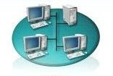
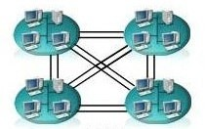
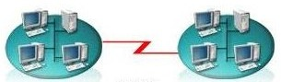
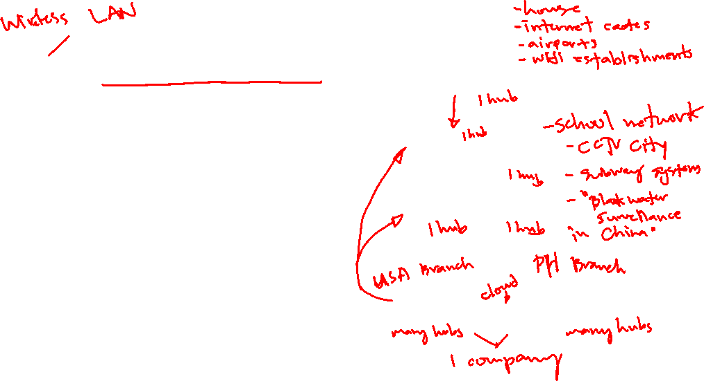
Types of Networks
Local Area Network (LAN)
Metropolitan Area Network (MAN)
Wide Area Network (WAN)

Slide 5





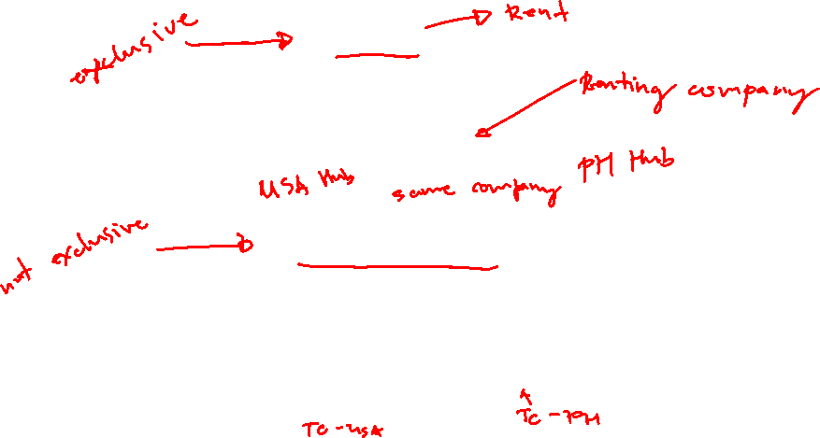
WAN Technologies
Leased Line
Synchronous serial
Circuit-switched
TELEPHONE COMPANY
Asynchronous serial. ISDN Layer 1

Slide 6
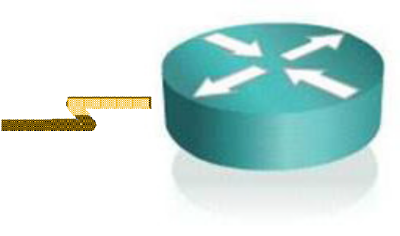



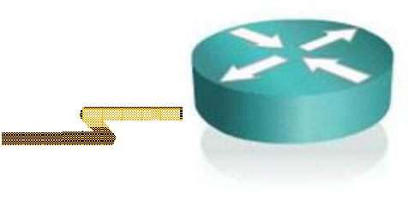

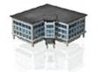

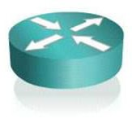
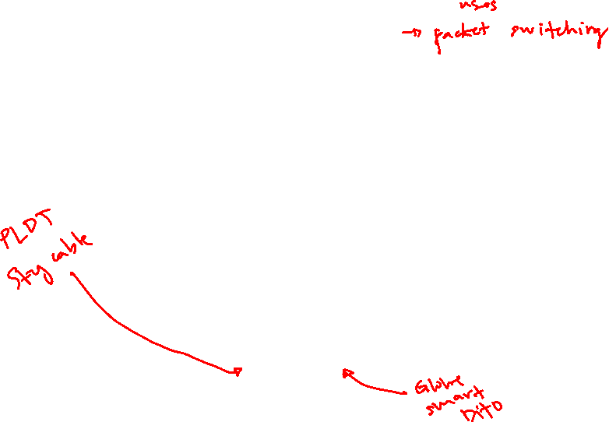
WAN Technologies (Cont.)
Frame-Relay
Synchronous serial
SERVICE PROVIDER
Broadband Access
SERVICE PROVIDER
Cable, DSL, Wireless WAN

Slide 7



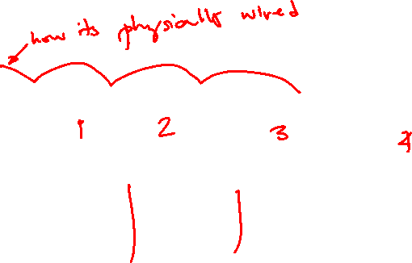
Network Topologies: Bus Topology
SEGMENT
Terminator
Terminator

Slide 8
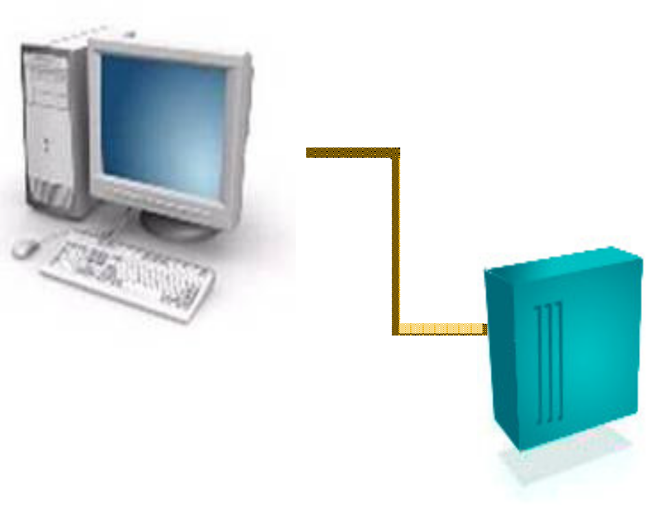
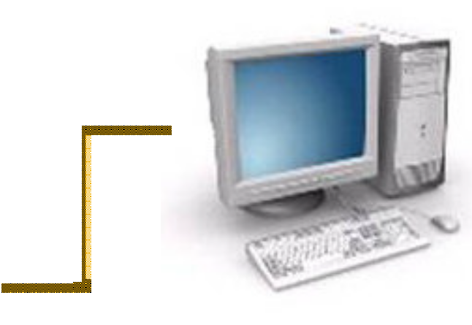

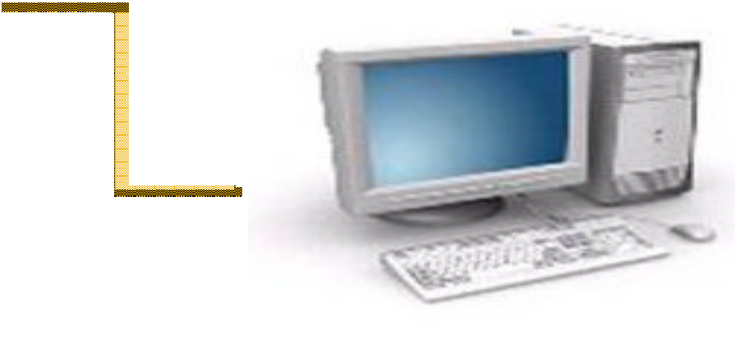
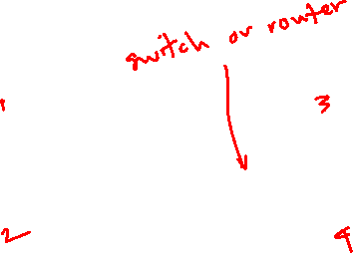
Network Topologies: Star Topology
Hub

Slide 9

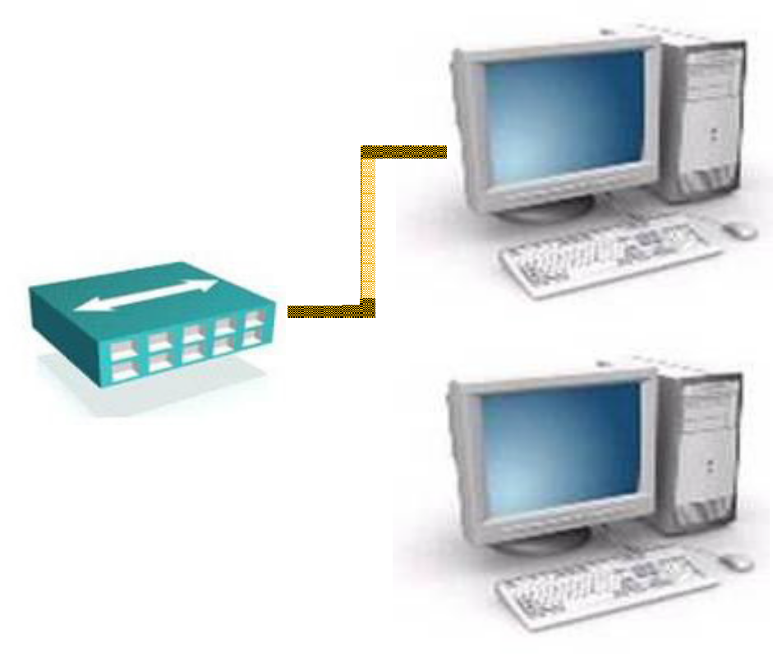
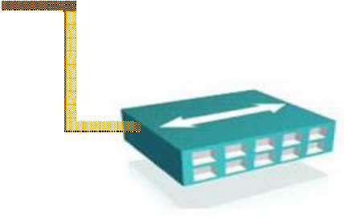

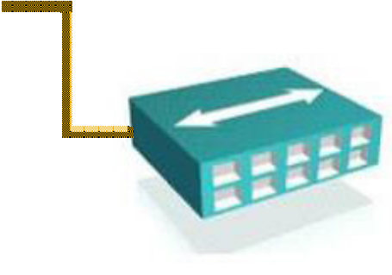


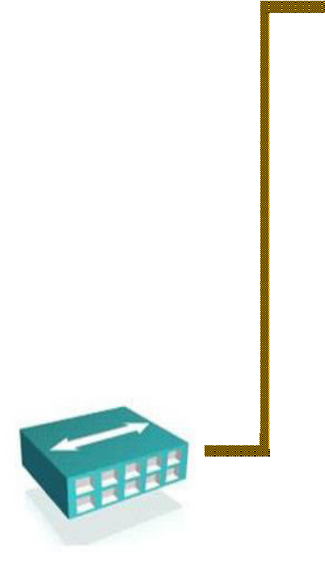
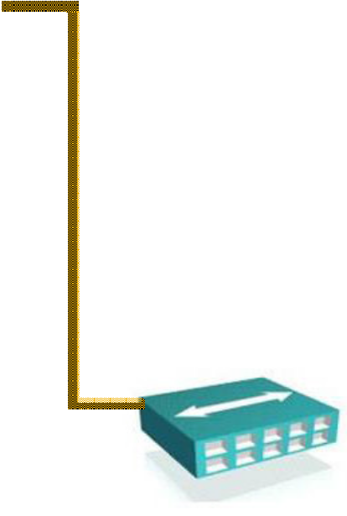

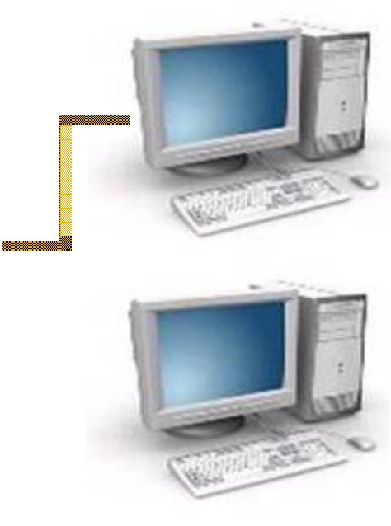



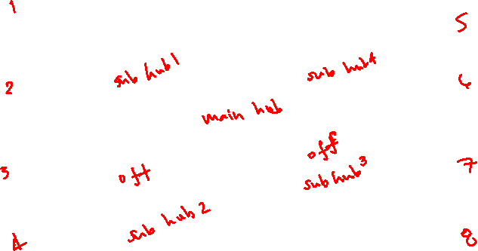
Network Topologies: Extended Star Topology

Slide 10







The OSI Model—
Why a Layered Network Model?
Reduces complexity
Standardizes interfaces
Facilitates modular engineering
Ensures interoperable technology
Accelerates evolution
Simplifies teaching and learning
Application
7
Presentation
6
Session
5
Transport
4
Network
3
Data Link
2
Physical
1

Slide 11



The Seven Layers of the OSI Model
Application
Application Layers (Upper Layers):
Network Processes to Applications
Data Representation
InterHost Communication
7
Presentation
6
Session
5
Transport
4
Network
3
Data Link
2
Physical
1

Slide 12

The Seven Layers of the OSI Model (Cont.)
Application
End To End Connections:
Handles transportation issues between hosts
Ensures data transport reliability
Establishes, maintains and terminates virtual circuits
Provides reliability through fault detection and recovery
Information flow control
7
Presentation
6
Session
5
Transport
4
Network
3
Data Link
2
Physical
1

Slide 13

The Seven Layers of the OSI Model (Cont.)
Application
Data Delivery:
Provides connectivity and path selection between two host systems
Routes data packets
Selects best path to deliver data
The Network layer prioritizes data known as Quality of Service (QoS)
7
Presentation
6
Session
5
Transport
4
Network
3
Data Link
2
Physical
1

Slide 14

The Seven Layers of the OSI Model (Cont.)
Application
Access to Media:
Defines how data is formatted for transmission and how access to the network is controlled
7
Presentation
6
Session
5
Transport
4
Network
3
Data Link
2
Physical
1

Slide 15

The Seven Layers of the OSI Model (Cont.)
Application
Binary Transmission:
Defines the electrical, mechanical, procedural, and functional specifications for activating, maintaining, and deactivating the physical link
7
Presentation
6
Session
5
Transport
4
Network
3
Data Link
2
Physical
1

Slide 16










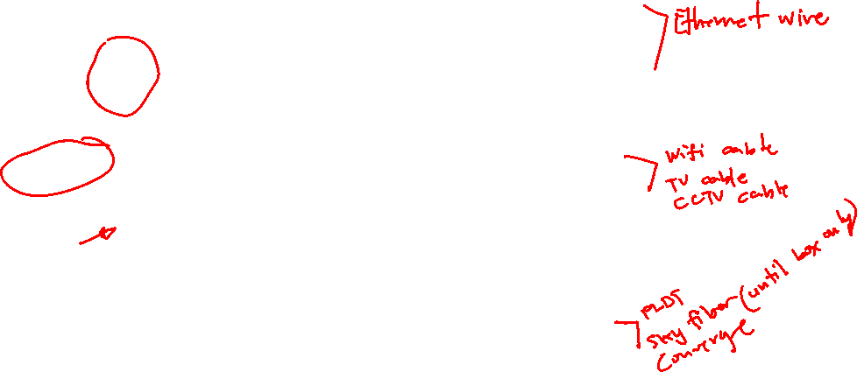
Physical Media Types
Twisted-Pair
Outer jacket
Twisted-Pair
RJ-45
Connector
Color-Coded Plastic Insulation
Coaxial
Outer jacket
Braided Copper Shielding
Copper Conductor
BNC
Connector
Plastic Insulation
Fiber Optics
Outer jacket
Kevlar Reinforcing Material
Glass and Fiber Cladding
SC
Connector
Plastic Shield

Slide 17









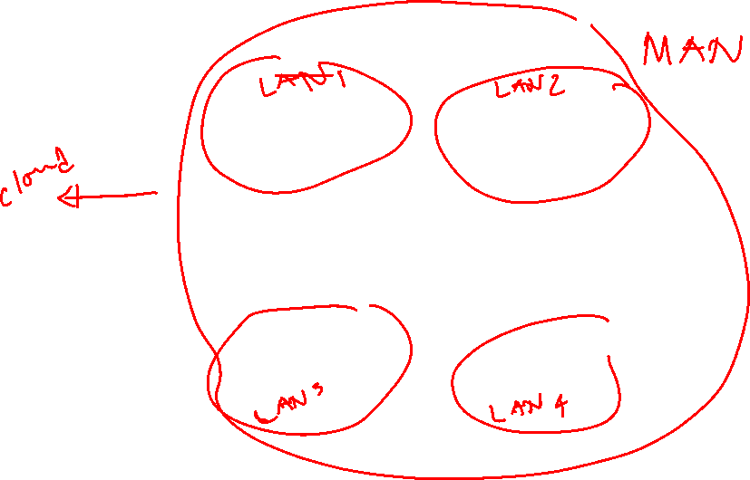
Physical Media Types (Cont.)
Wireless
INTERNET
ETHERNET BACKBONE

Slide 18
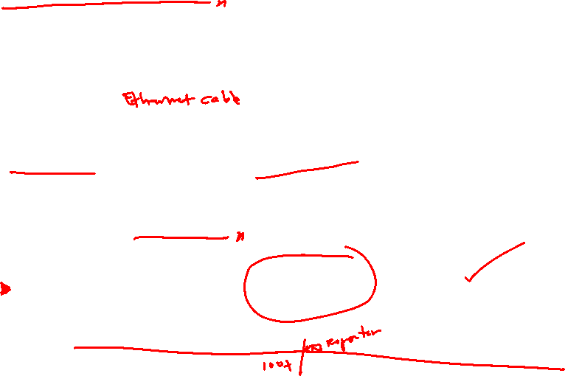
Physical Media Comparison
 | Twisted Pair | Coaxial | Fiber Optic | Wireless LAN
Bandwidth | Up to 1 Gbps | 10–100 Mbps | Up to 10 Gbps or higher | Up to 54 Mbps
Distance | Up to 100 m | Up to 500 m | Up to 60 km | Up to 100 m
Price | Least expensive | Inexpensive | Most expensive | Moderate

Slide 19

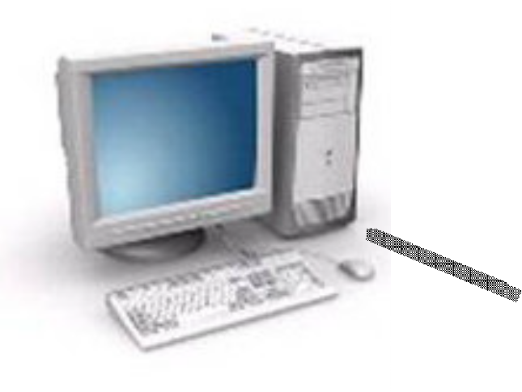
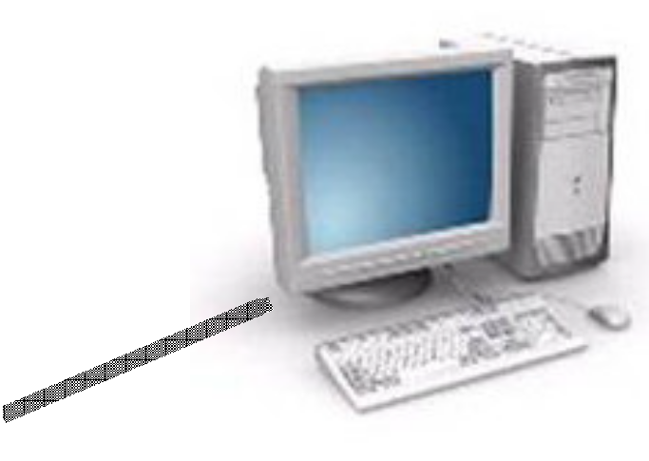


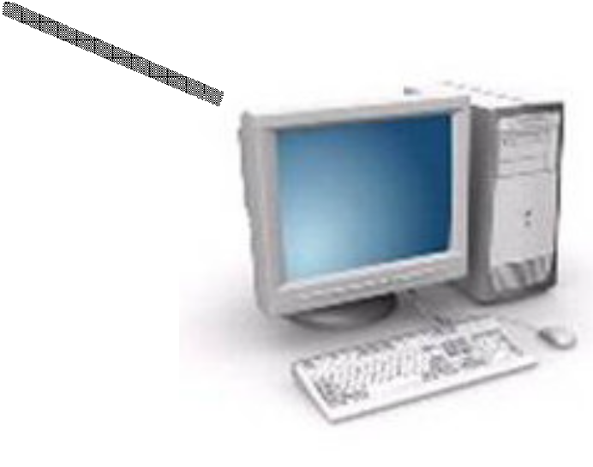

Hub or Repeater
A hub (concentrator) is a device that repeats the signals it receives on one port to all other ports. It is a central connection point for several network devices.
Hub

Slide 20
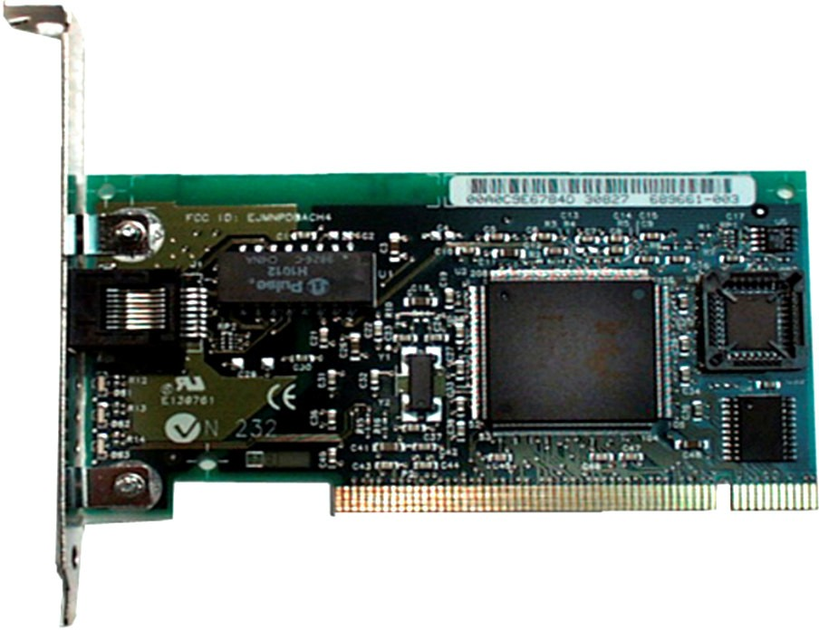
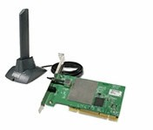

Network Interface Card

Slide 21
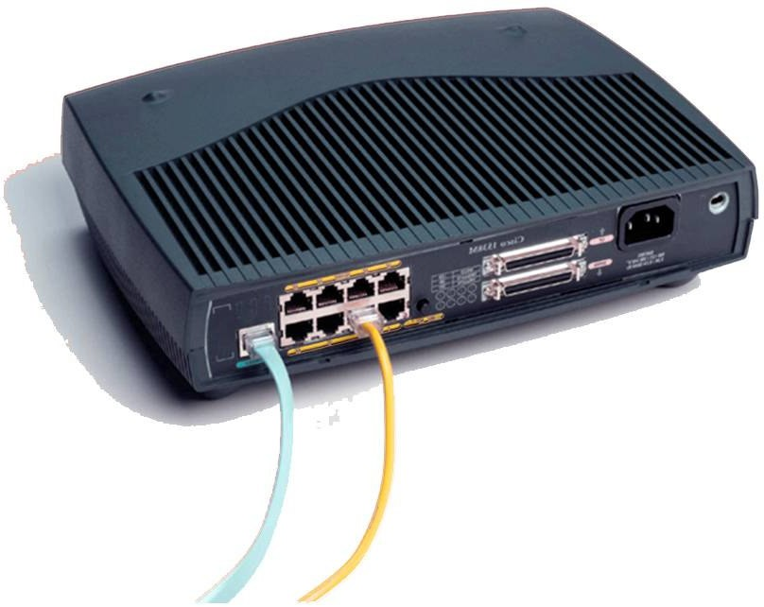
Hub (Multiport Repeater)

Slide 22

WAN—Physical Layer Implementations
Physical layer implementations vary
Cable specifications define speed of link
Cisco HDLC | PPP | Frame Relay | ISDN BRI (with PPP) | DSL Modem | Cable Modem
EIA/TIA-232 |  |  | RJ-48 | RJ-11 | BNC
EIA/TIA-449 X.21 V.24 V.35 HSSI |  |  | Note: ISDN BRI cable pinouts are different than the pinouts for Ethernet. The RJ-48 and RJ-45 look the same, but the pinouts are different. | Note: Works over telephone line | Note: Works over Cable TV line

Slide 23
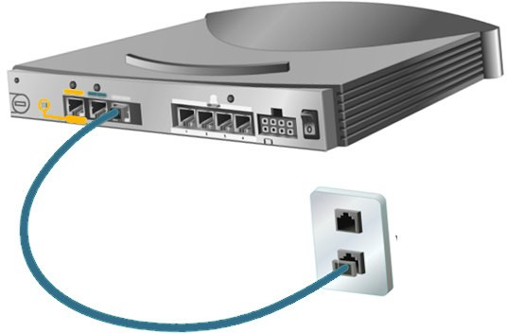
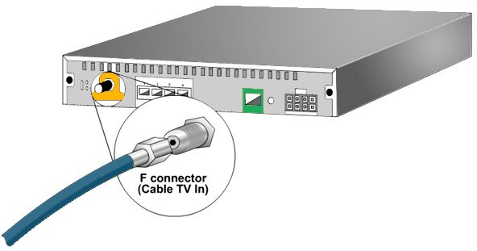
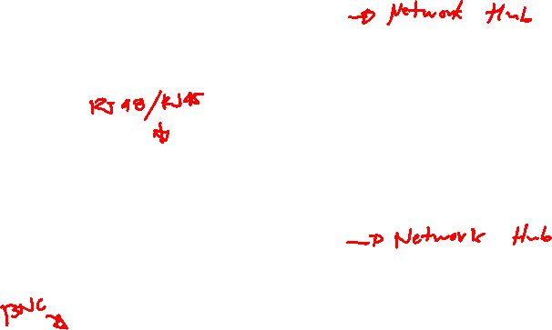
Physical Media
WAN
Wall Jack

Slide 24

Data Link Layer
Data Link layer protocols create, transmit, and receive packets. This layer is also responsible for logical MAC addressing and LLC processing, creating logical topologies, and controlling media access.
Data Link
2

Slide 25

MAC Address
The network interface card address, called the hardware address, is protocol-independent and is usually assigned at the factory. This address is technically called the media access control address (MAC) because it is found on the MAC sub layer of the Data Link layer.
Data Link
00-0C-F1-5E-BE-F2
2
MAC Address =
Hardware Address

Slide 26

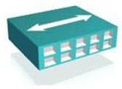
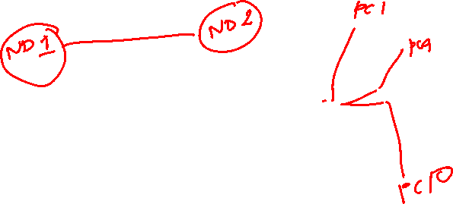
Data Link Devices
The Data Link layer is manipulated by two devices: bridges and switches. These are more complex and more expensive than their Physical layer counterparts, but they do have advantages.
Bridges
Switches

Slide 27
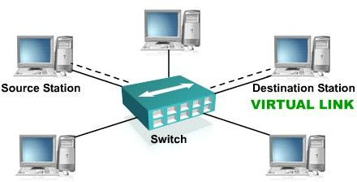
Switch
When a switch receives data the switch examines the data link header for the MAC address of the destination station and forwards it to the correct port. This opens a path between ports that can use the full bandwidth of the topology.

Slide 28

Network Layer
The network layer provides connectivity and path selection between two host systems that may be located on geographically separated networks
Network
3

Slide 29

Network Layer Devices
The devices that operate at the Network layer are routers and Layer 3 Switches
Router
Layer 3 Switch

Slide 30
Network Layer (Cont.)
IP is a standard that defines the manner in which the network layers of two hosts interact. IP addresses are 32 bit long, hierarchical addressing scheme.
Network
192.168.6.17
3
IP Address
=
Logical Address

Slide 31
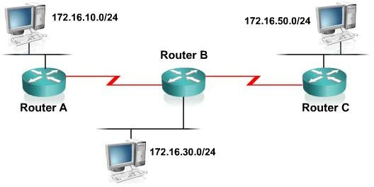

Routers
Routers facilitate communication within this internet work. It decides how to send packets within the network so that they arrive at their destination.

Slide 32

Layer 3 Switches
The Layer 3 switch functions at the Network layer and performs the multiport, virtual LAN, data pipelining functions of a standard Layer 2 switch. It can also perform basic routing functions between virtual LANs.
Layer 3 Switch

Slide 33




Multilayer Switching
Application
Combines functionality of:
Layer 2 switching
Layer 3 switching
Layer 4 switching
High-speed scalability
Low latency compared to routers
7
Presentation
6
Session
5
Transport
4
Network
3
Data Link
2
Physical
1

Slide 34

Transport Layer Implementations
The Transport layer is charge of the reliable/unreliable transport of data. It can be implemented as TCP or UDP.
TCP
4
Transport
UDP

Slide 35
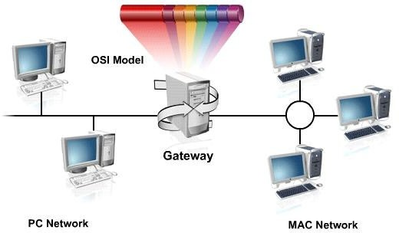
Gateway
A gateway is a combination of hardware and software that connects dissimilar network environments. It performs translations at multiple layers of the open system interconnection (OSI) model.
OSI Model
Gateway
PC Network
MAC Network

Slide 36
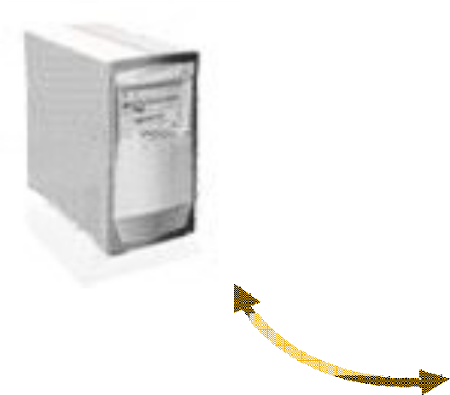


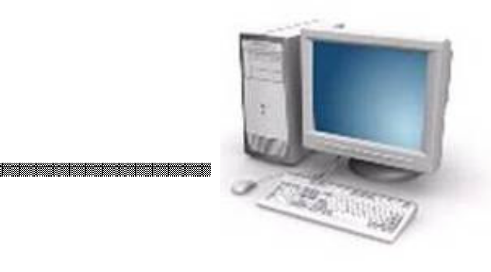
Firewalls
A firewall is a system or group of systems that manages access between two or more networks
DMZ
Network
INTERNET
Outside Network
Inside Network

Slide 37
Summary
This lesson covered the following main topics:
The function and operation of a hub, a switch, and a router
The function and operation of Layer 2 switching, Layer 3 switching, and routing
The OSI model
Functionality of LAN, MAN and WAN networks
Possible media types for LAN and WAN connections
The function and definition of firewalls and gateways

